Slide 1

CSE 111 Project:
NBA Stats Database
Christopher Tapia Henry Wang

Slide 2
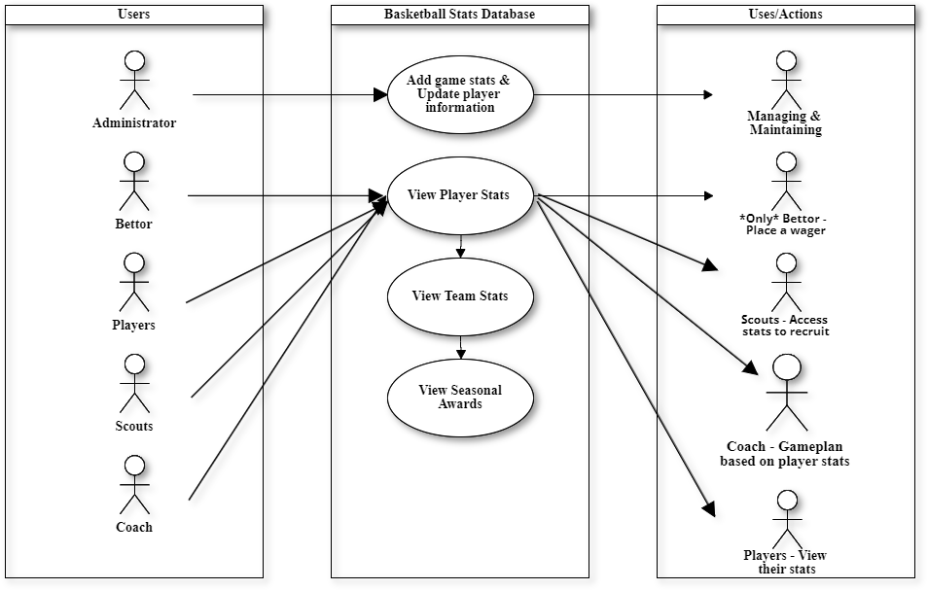
UML Use-Case Diagram
Main Use Cases:
Ourselves/Admins to manage and maintain the database
Bettor can place wagers based on player or team stats
Scouts can analyze players stats for recruitment
Coach can analyze a team & player stats to game plan
Players can look at their own stats to chase seasonal awards

Slide 3
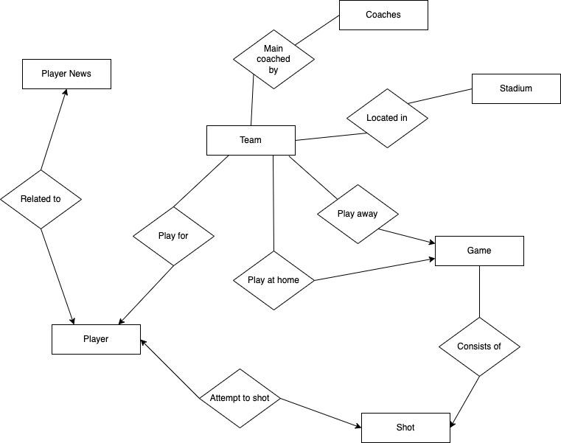
Entity/Relationship Diagram
Relation Types:
2 many to many relations
Players - Player News
Players - Shots
2 one to one relations
Team - Coach
Team - Stadium
4 one to many relations
Team - Player
Game - Shot
Team - Game (Away)
Team - Game (Home)

Slide 4
Many-many Relation Specification
One player can be related to many news, and one news can be related to many players
One player can shoot many types of shots, and one type of shot can be shot by many players

Slide 5
One-to-many Relation Specification
One team can play many away games, and one play away game can be played by one teams
One team can play many home games, and one home game can be played by one teams
One player can play only for one team, and one team can have many players play for it
One game consists of many shots, and one (or many) shots can be part of one game

Slide 6
One-to-one Relation Specification
One team can be coached by only one main coach, and one main coach can coach only one team
One team can be located only in one stadium, and one stadium is home to only one team

Slide 7
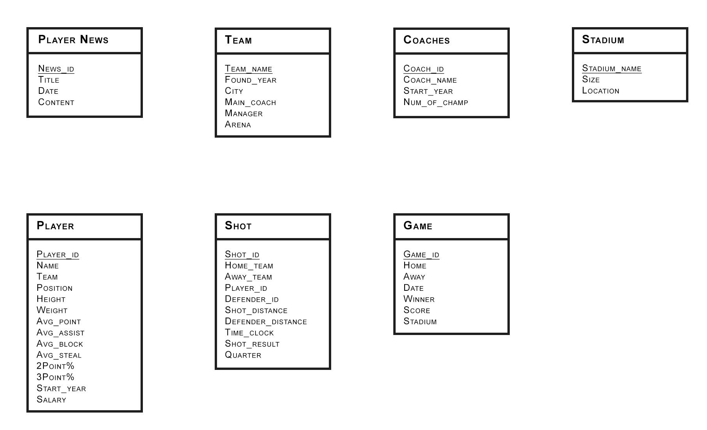
Database Tables

